Slide 1


Building a Blockchain
Building a Node (Peers + Blocks + Transactions), Wallet App, Miners, Faucet, Block Explorer
Svetlin Nakov
Blockchain Trainer
Academy School of Blockchain
http://kingsland.academy

Slide 2


Table of Contents
Building a Blockchain Node
Peers, Blocks, Transactions, Addresses, Balances
Designing the REST API
Blockchain System Architecture
Building the Mining Software
Building a Faucet App
Building a Wallet App
Building an Block Explorer Site

Slide 3
Blockchain System Architecture
Node
Node
Miner
Node
Wallet
Block Explorer
Faucet
Nodes, Miners, Faucet, Wallets, Explorer

Slide 4
Blockchain System Architecture
Node
Wallet
Block Explorer
Peers
Blocks
Transactions
Balances
Mining jobs
Keep private keys
Check balances
Send transactions
View blocks
View confirmed transactions
View pending transactions
View accounts and balances
View peers map
Miner
Faucet
Get mining block
Mine (PoW)
Submit result
Request 5 coins

Slide 5
Keys and Addresses
Elliptic curve cryptography (ECC), using the secp256k1 curve
private key
privKey
public key
= privKey * G
address
= ripemd(pubKey)
256-bit number
64 hex digits
{x, y} - 256-bit numbers
compressed: {x, 0/1}
65 hex digits
RIPEMD-160 of the compressed public key
40 hex digits
7e4670ae70c98d24f3662c172dc510a085578b9ccc717e6c2f4e547edd960a34
c74a8458cd7a7e48f4b7ae6f4ae9f56c5c88c0f03e7c59cb4132b9d9d1600bba1
c3293572dbe6ebc60de4a20ed0e21446cae66b17

Slide 6
Coins and Rewards
Coins are 64-bit integers (no real numbers!)
1 coin = 1 000 milli-coins = 1 000 000 micro-coins
All transfers, fees, block awards are defined in micro-coins
E.g. a transaction fee can be 20 micro-coins
The block reward (per mined block) is static
5 000 000 micro-coins

Slide 7
Building the Blockchain Node
Peers, Blocks, Transactions, Addresses, Balances, Designing the REST API

Slide 8
Building the Blockchain Node: Node
Node
Peers: URL[]
Blocks: Block[]
PendingTransactions: Transaction[]
Difficulty: integer
MiningJobs: map(blockDataHash => Block)
Consensus algorithm: proof of work (SHA256 hashing)
The chain with most work (~ the longest) is the main chain
Communication in the network: REST API (for simplicity)

Slide 9
REST Endpoints: Info
GET
http://{host}:5555/info
{
"about": "SoftUniChain/0.9-csharp",
"nodeUrl": "http://chain-node-03.herokuapp.com",
"peers": 2, "difficulty": 5,
"blocks": 25, "cumulativeDifficulty": 127
"confirmedTransactions": 208,
"pendingTransactions": 7
}
200 OK
Nodes can provide additional data, e.g. at additional REST endpoint, e.g. total number of addresses, total coins issued, etc.

Slide 10
Building the Blockchain Node: Blocks
Block
Index: number
Transactions: Transaction[]
Difficulty: number
PrevBlockHash: hex_number
MinedBy: address
BlockDataHash: hex_number
Nonce: number
DateCreated: timestamp
BlockHash: hex_number

Slide 11
REST Endpoints: All Blocks
GET
http://{host}:5555/blocks
[ {
"index": 17,
"transactions": […],
"difficulty": 5,
"prevBlockHash": "d279fa6a31ae4fb07cfd9cf7f35cc01f…3cf20a",
"minedBy": "91c43337992580bca7d5f758d09e88f9b7032a65",
"blockDataHash": "5d845cddcd4404ecfd5476fd6b1cf0e5…a80cd3",
"nonce": 2455432,
"dateCreated": "2018-02-01T23:23:56.337Z",
"blockHash": "00000abf2f3d86d5c000c0aa7a425a6a4a65…cf4c"
}, {…}, {…}, …]
200 OK

Slide 12
REST Endpoints: Block by Number
GET
http://{host}:5555/blocks/11
{
"index": 11,
"transactions": […],
"difficulty": 4,
"prevBlockHash": "e69cb1368aa174c9e5548f4e5adb0d3b4c6c…ef25",
"minedBy": "91c43337992580bca7d5f758d09e88f9b7032a65",
"blockDataHash": "5d845cddcd4404ecfd5476fd6b1cf0e5…a80cd3",
"nonce": 2455432,
"dateCreated": "2018-02-01T22:58:23.129Z",
"blockHash": "d2c6ee29ff14b49e31c409af985824ea12afccc8…e4cd"
}
200 OK / 404 Not Found

Slide 13
Building the Blockchain Node: Transactions
Transaction
From: address
To: address
Value: integer
Fee: integer
DateCreated: timestamp
SenderPubKey: hex_number
SenderSignature: hex_number[2]
TransactionHash: hex_number
MinedInBlockIndex: number / null
TransferSuccessful: bool

Slide 14
REST Endpoints: Get Transaction Info
GET
http://{host}:5555/transactions/44fc…176a
200 OK / 404 Not Found
{
"from": "44fe0696beb6e24541cc0e8728276c9ec3af2675",
"to": "9a9f082f37270ff54c5ca4204a0e4da6951fe917",
"value": 25000, "fee": 10,
"dateCreated": "2018-02-10T17:53:48.972Z",
"senderPubKey": "2a1d79fb8743d0a4a8501e0028079bcf82a4f…eae1",
"senderSignature": ["e20c…a3c29df79f", "cf92…0acd0c2ffe56"]
"transactionHash": "4dfc3e0ef89ed603ed54e47435a18b836b…176a"
"minedInBlockIndex": 7,
"transferSuccessful": true
}
The last two fields appear only after the transaction is mined

Slide 15
REST Endpoints: Get Confirmed Transactions
GET
http://{host}:5555/transactions/confirmed
[{
"from": "44fe0696beb6e24541cc0e8728276c9ec3af2675",
"to": "9a9f082f37270ff54c5ca4204a0e4da6951fe917",
"value": 25000, "fee": 10,
"dateCreated": "2018-02-10T17:53:48.972Z",
"senderPubKey": "2a1d79fb8743d0a4a8501e0028079bcf82a4f…eae1",
"senderSignature": ["e20c…a3c29df79f", "cf92…0acd0c2ffe56"]
"transactionHash": "4dfc3e0ef89ed603ed54e47435a18b836b…176a",
"minedInBlockIndex": 7, "transferSuccessful": true
},
{ … }, { … }]
200 OK

Slide 16
REST Endpoints: Get Pending Transactions
GET
http://{host}:5555/transactions/pending
[{
"from": "44fe0696beb6e24541cc0e8728276c9ec3af2675",
"to": "9a9f082f37270ff54c5ca4204a0e4da6951fe917",
"value": 25000, "fee": 10,
"dateCreated": "2018-02-10T17:53:48.972Z",
"senderPubKey": "2a1d79fb8743d0a4a8501e0028079bcf82a4f…eae1",
"senderSignature": ["e20c…a3c29df79f", "cf92…0acd0c2ffe56"]
"transactionHash": "4dfc3e0ef89ed603ed54e47435a18b836b…176a"
},
{ … }, { … }]
200 OK

Slide 17
REST Endpoints: List Transactions for Address
GET
http://{host}:5555/address/44fe…2a75/transactions
{
"address": "44fe0696beb6e24541cc0e8728276c9ec3af2a75",
"transactions": [{ … }, { … }, { … }]
}
200 OK / 404 Not Found
All transactions, associated with the given address are returned
Confirmed transactions (successful or not) + pending transactions
Order the transactions by date

Slide 18
REST Endpoints: Get Balance for Address
GET
http://{host}:5555/address/44fe…2a75/balance
The safe confirm count = 6
{
"address": "44fe0696beb6e24541cc0e8728276c9ec3af2a75",
"confirmedBalance": {"confirmations": 28, "balance": 120},
"lastMinedBalance": {"confirmations": 1, "balance": 115},
"pendingBalance": {"confirmations": 0, "balance": 170}
}
200 OK / 404 Not Found
The address balance is calculated by iterating over all transactions
For each block and for each successful transaction for the specified address, sum the values received and spent, matching the confirmations count

Slide 19
Creating a Transaction
To create a transaction you need:
Sender public key (compressed) – 65 hex digits
Recipient address (to) – 40 hex digits
Transfer value – positive integer; Fee for the miners – positive integer
Date & time (to avoid replay attacks) – ISO8601 UTC datetime string
The sender's address (from) is extracted from the public key
{ "from": "c3293572dbe6ebc60de4a20ed0e21446cae66b17",
"to": "f51362b7351ef62253a227a77751ad9b2302f911",
"senderPubKey": "c74a8458cd7a7e48f4b7ae6f4ae9f56c5c88c0f03e7…bba1"
"value": 25000, "fee": 10, "dateCreated": "2018-02-10T17:53:48.972Z",
}

Slide 20
Signing a Transaction
To sign a transaction, a private + public key are required
First, put the transaction data in a JSON object (without signature)
The from address should always match the sender public key
Remove any whitespace, calculate SHA256 and sign it
{
"from": "c3293572dbe6ebc60de4a20ed0e21446cae66b17",
"to": "f51362b7351ef62253a227a77751ad9b2302f911",
"senderPubKey": "c74a8458cd7a7e48f4b7ae6f4ae9f56c5c88c0f03e7…bba1"
"value": 25000, "fee": 10, "dateCreated": "2018-02-10T17:53:48.972Z",
}

Slide 21
Signing a Transaction – Example
Sender's private key:
Corresponding public key (compressed):
Sender address:
Sample transaction data (still not signed):
7e4670ae70c98d24f3662c172dc510a085578b9ccc717e6c2f4e547edd960a34
c74a8458cd7a7e48f4b7ae6f4ae9f56c5c88c0f03e7c59cb4132b9d9d1600bba1
c3293572dbe6ebc60de4a20ed0e21446cae66b17
{ "from": "c3293572dbe6ebc60de4a20ed0e21446cae66b17",
"to": "f51362b7351ef62253a227a77751ad9b2302f911",
"senderPubKey": "c74a8458cd7a7e48f4b7ae6f4ae9f56c5c88c0f03e7…bba1"
"value": 25000, "fee": 10, "dateCreated": "2018-02-10T17:53:48.972Z" }

Slide 22
Signing a Transaction – Example (2)
JSON-serialized transaction data for signing (whitespace removed):
Transaction hash for signing (SHA-256):
ECDSA signature of the above hash (signed signature bytes):
The ECDSA signature consists of 2 * 64 hex digits (2 * 256 bits)
{"from":"c3293572dbe6ebc60de4a20ed0e21446cae66b17","to":"f51362b7351ef62253a227a77751ad9b2302f911","senderPubKey":"c74a8458cd7a7e48f4b7ae6f4ae9f56c5c88c0f03e7c59cb4132b9d9d1600bba1","value":25000,"fee":10,"dateCreated":"2018-02-10T17:53:48.972Z"}
f241a5598fbe5ba048918fa1cafe8eb727794cfb0f72f425ba332479de22e2b7
r = 1aaf55dcb11060749b391d547f37b4727222dcb90e793d9bdb945c64fe4968b0
s = 87250a2841f7a56910b0f7ebdd067589632ccf19d352c15f16cfdba9b7687960

Slide 23
Signing a Transaction – Example (3)
Signed transaction (the signature is added in the JSON):
Use deterministic ECDSA signature, based on the curve secp256k1 and RFC-6979 with HMAC-SHA256
{
"from": "c3293572dbe6ebc60de4a20ed0e21446cae66b17",
"to": "f51362b7351ef62253a227a77751ad9b2302f911",
"senderPubKey":
"c74a8458cd7a7e48f4b7ae6f4ae9f56c5c88c0f03e7c59cb4132b9d9d1600bba1",
"value": 25000, "fee": 10, "dateCreated": "2018-02-10T17:53:48.972Z",
"senderSignature": [
"1aaf55dcb11060749b391d547f37b4727222dcb90e793d9bdb945c64fe4968b0",
"87250a2841f7a56910b0f7ebdd067589632ccf19d352c15f16cfdba9b7687960"
]
}

Slide 24
REST Endpoints: Send Transaction
POST
http://{host}:5555/transactions/send
{
"from": "c3293572dbe6ebc60de4a20ed0e21446cae66b17",
"to": "f51362b7351ef62253a227a77751ad9b2302f911",
"senderPubKey":
"c74a8458cd7a7e48f4b7ae6f4ae9f56c5c88c0f03e7c59cb4132b9d9d1600bba1",
"value": 25000, "fee": 10, "dateCreated": "2018-02-10T17:53:48.972Z",
"senderSignature": ["1aaf55dcb1…68b0","87250a2841…7960"]
}
201 Created / 400 Bad Request
{ "transactionHash": "cd8d9a345bb208c6f9b8acd6b8eefe6…20c8a" }
The transaction SHA256 hash is calculated when received, over all fields from the received JSON object (including the signature)

Slide 25
Send Transactions
For each received transaction the Node does the following:
Calculates the transaction hash
Checks for collisions → duplicated transactions are skipped
Checks for missing / invalid fields
Validates the transaction signature
Puts the transaction in the "pending transactions" pool
Sends the transaction to all peer nodes through the REST API
The transaction is sent from peer to peer until it reaches the entire network

Slide 26
REST Endpoints: Send Transaction → Error
POST
http://{host}:5555/transactions/send
{
"invalid": "data"
}
400 Bad Request
{
"errorMsg": "Invalid transaction: field 'from' is missing"
}
In case of error, the response holds a JSON object holding the error message (like shown above)

Slide 27
REST Endpoints: Notify About New Block
POST
http://{host}:5555/blocks/notify
{ "index": 51, "cumulativeDifficulty": 283,
"peerUrl": "http://chain-node-03.herokuapp.com:5555" }
200 OK
{ "message": "Thank you for the notification." }
The notification comes from another node which have mined or received a new block from a peer
The current node should check whether the new block ends to a longer chain (based on the cumulative difficulty) and then accept the new chain
The new chain is downloaded from peerUrl/blocks (additional request)
This notification might be also sent over a Web Socket

Slide 28
REST Endpoints: List All Peers
GET
http://{host}:5555/peers
200 OK
[
"http://212.50.11.109:5555",
"http://af6c7a.ngrok.org:5555"
]
Peers are identified by their URL
Each node is connected to a few neighbor peers (not to all peers in the network)

Slide 29
REST Endpoints: Connect a Peer
POST
http://{host}:5555/peers
{
"peerUrl": "http://212.50.11.109:5555"
}
200 OK / 409 Conflict
{
"message": "Added peer: http://212.50.11.109:5555"
}
Always keep the connections bi-directional
If Alice is connected to Bob, then Bob should also be connected to Alice

Slide 30

The Mining Software
Proof-of-Work Mining

Slide 31
Building the Mining Software: Get Block
GET
http://{host}:5555/mining/get-mining-job/{miner-address}
{
"index": 50,
"transactionsIncluded": 17,
"expectedReward": 5000350, "rewardAddress": "9a9f08…fe917",
"blockDataHash": "d2c6ee29ff14b499af985824ea12afccc8…e4cd",
}
200 OK / 400 Bad Request
Nodes act like mining pools
Prepare the next block candidate for mining and give it to the miners
Miners submit back the mined hash + nonce + timestamp to the Node

Slide 32
The Coinbase Transaction (Reward)
A special coinbase transaction is inserted before all transactions in the candidate block, to transfer the block reward + fees
No sender public key and signature
{
"from": "0000000000000000000000000000000000000000",
"to": "9a9f082f37270ff54c5ca4204a0e4da6951fe917",
"value": 5000350,
"fee": 0,
"dateCreated": "2018-02-10T17:53:48.972Z",
"transactionHash": "4dfc3e0ef89ed603ed54e47435a18b836b…176a",
"transferSuccessful": true,
}

Slide 33
How to Calculate the Block Data Hash?
Nodes prepare block candidates and calculate their data hash
Use JSON representation of the block, with the same order of the keys like at the example, no whitespace
Dates should come in ISO-8601 format
Hex numbers are always written in lowercase, e.g. c6af, not C6AF
The JSON data is hashed using SHA256
string json = toJSON(block_data)
string block_data_hash = SHA256(json)

Slide 34
Block Candidate JSON – Example
{
"index": 11,
"transactions": [
{ "from": "…", "to": "…", "value": …, "dateCreated": "…",
"senderPubKey": "…", "senderSignature": ["…", "…"],
"transactionHash": "…", "transferSuccessful": …,
"minedInBlockIndex": … },
{ … }, { … }, { … }, …
],
"difficulty": 4, "prevBlockHash": "c53ff3…a78",
"minedBy": "91c43337992580bca7d5f758d09e88f9b7032a65",
"blockDataHash": "e69cb1368aa174c9e5548f4e5adb0d3b4c6c…ef25"
}

Slide 35
Transactions in the Block Candidates
Each transaction in the block candidate (after processing) is represented as a JSON object like this:
{
"from": "44fe0696beb6e24541cc0e8728276c9ec3af2675",
"to": "9a9f082f37270ff54c5ca4204a0e4da6951fe917",
"value": 25000, "fee": 10,
"dateCreated": "2018-02-10T17:53:48.972Z",
"senderPubKey": "2a1d79fb8743d0a4a8501e0028079bcf82a4f…eae1",
"senderSignature": ["e20c…a3c29df79f", "cf92…0acd0c2ffe56"],
"transactionHash": "4dfc3e0ef89ed603ed54e47435a18b836b…176a",
"transferSuccessful": true, "minedInBlockIndex": 73
}

Slide 36
The Mining Process: Preparation
When a Miner requests a block for mining, the node prepares it:
Creates the next block candidate: executes all pending transactions and adds them in the block candidate
Calculates the block data hash and provides it to the miner
The Node keeps a separate block candidate for each miner
It holds map<blockDataHash → block>
If a miner requests a block candidate again, the Node sends an updated block (holding more transactions)
The Node will always return the latest block for mining, holding the latest pending transactions (to collect maximum fees)

Slide 37
The Mining Process: Trying Many Hashes
The miner changes the nonce + timestamp in a loop until it finds a SHA256 hash starting with d zeroes (d == block difficulty)
The Miner submits the mined block hash to the Node
1-2 times per second the miner may take an updated block candidate from the Node
Block Candidate
BlockDataHash: hex_number
Nonce: number
DateCreated: timestamp
BlockHash: hex_number
SHA256

Slide 38
Building the Miners Hash
Calculating the block hash:
Example of block data for hashing (by the miners):
The hash is a proof-of-work of difficulty 5 (starts with 5 zeroes)
minedBlockHash = SHA256(blockDataHash|dateCreated|nonce)
df8f114897188bcc68b97ebe2b673d3c92de986024abe565df0a4f8702c1742b|2018-02-11T20:31:32.397Z|1453826
SHA256
000001c2093443767ea191ee058fa034593b41f45ce8001f0da4f888e1eab69b

Slide 39
Processing a Mined Block
Miners submit their mined hash, the node builds the mined block and propagates it through the network
When a miner submits correct proof-of-work hash
The node finds the block candidate by its blockDataHash
The node verifies the hash and builds the next block
The block candidate is merged with the nonce + timestamp + hash
Then if the block is still not mined, the chain is extended
Sometimes other miners can be faster → the mined block is expired
Then all peers are notified about the new mined block

Slide 40
Building the Mining Software: Submit Block
POST
http://{host}:5555/mining/submit-mined-block
{
"blockDataHash": "df8f114897188bcc68b97ebe2b673d3c92d…742b",
"dateCreated": "2018-02-11T20:38:56.692Z", "nonce": 1177127,
"blockHash": "00000641e21ffceea0fce17c6b2f21668cc52886…745b"
}
{
"status": "accepted",
"message":
"Block accepted, reward paid: 5000350 microcoins"
}
200 OK / 404 Not Found / 400 Bad Request

Slide 41
The Mining Pool in the Nodes
Internally nodes implement a simple mining pool
Consists of mining jobs (block candidates sent to the miners)
Each mining job has a blockDataHash and belongs to some miner
The coinbase transaction in the job is assigned to the miner's address
After a new block is mined in the network (by someone)
All pending mining jobs are deleted (because are no longer valid)
When a miner submits a mined block later → 404 "Not Found"
MiningJobs: map<blockDataHash => Block candidate>

Slide 42
Network Difficulty: Static or Dynamic
The network difficulty in each block candidate
Specifies the number of leading zeroes in the expected mined block SHA256 hash, e.g. 5 leading zeroes
Difficulty might be a constant number (hard-coded in the nodes)
Advanced developers might adjust the difficulty over the time using some calculations to target a fixed number of seconds between blocks
For example, if the target block time == 5 seconds
For the next block, the difficulty can be dynamically adjusted:
If average block time for the entire chain < 5 → difficulty++
If average block time for the entire chain > 5 → difficulty--

Slide 43

Faucet App
Creating a Faucet Web App

Slide 44
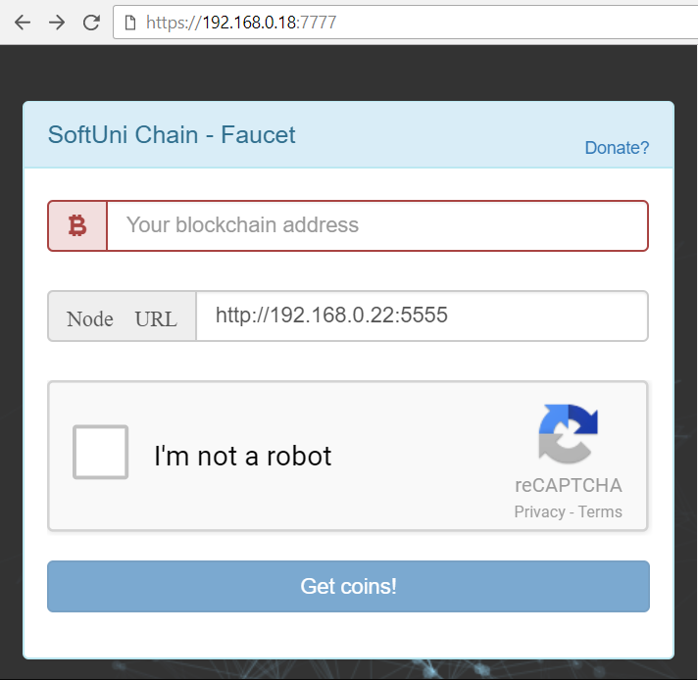
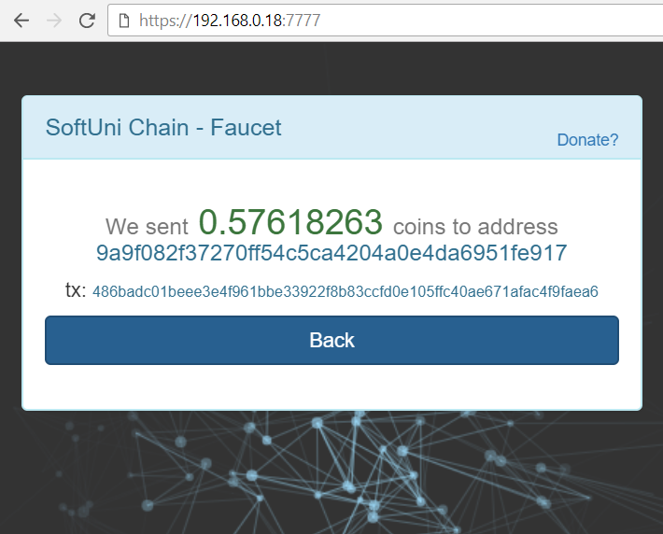
Faucet App

Slide 45
The Faucet App
The Faucet App is web applications that holds some coins
E.g. donated from the genesis transaction
Or mined by someone and donated to the faucet
The faucet works like a wallet with hard-coded private key
It sends a 1 coin (or less) to anyone who requests coins
Limits: one request per address per hour + captcha
For each request, the faucet creates a transaction, signs it and sends it to the specified Node URL (through HTTP POST)

Slide 46

Wallet App
Generating & Storing Keys, Check Account Balances, Signing & Sending Transactions

Slide 47
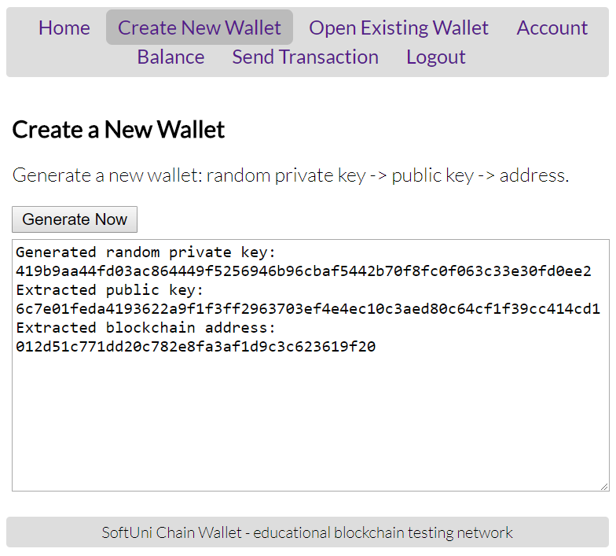
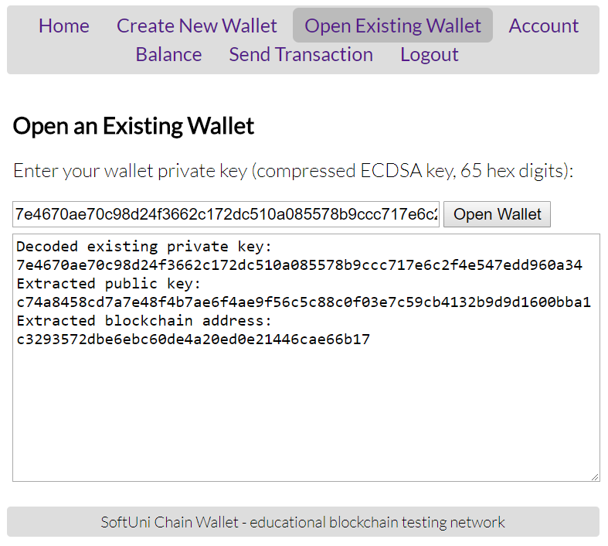
The Wallet App: Sample Screenshots

Slide 48
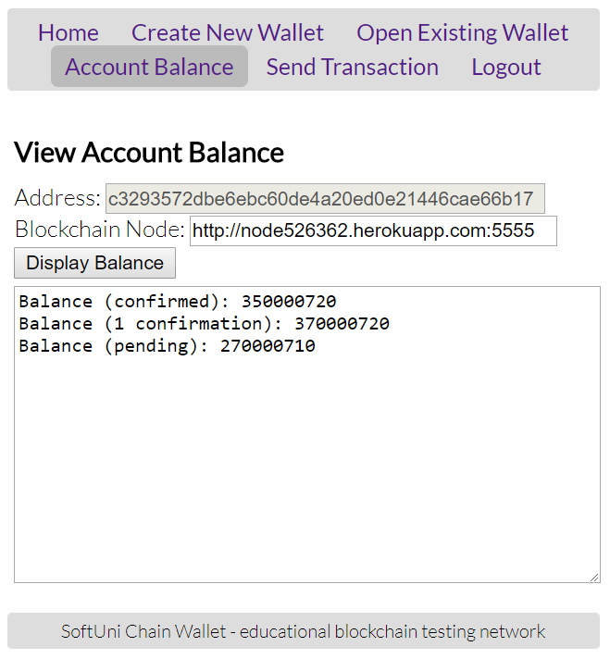
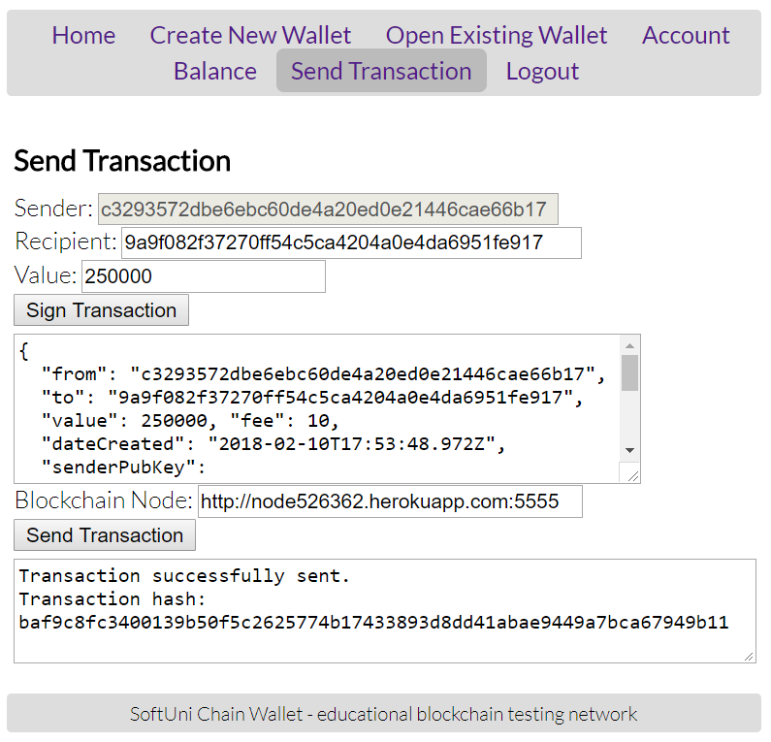
The Wallet App: Sample Screenshots (2)

Slide 49
Wallet App
The Wallet App is desktop / mobile / web application
Manages private keys + signs and sends transactions
It might be based on the HD wallet standards (BIP-39 / BIP-32)
Or for simplicity, could hold just a single private key
Functionality:
Create new wallet / open existing wallet (by data + password)
Check account balance (for certain private key's address)
Create, sign and send transactions

Slide 50
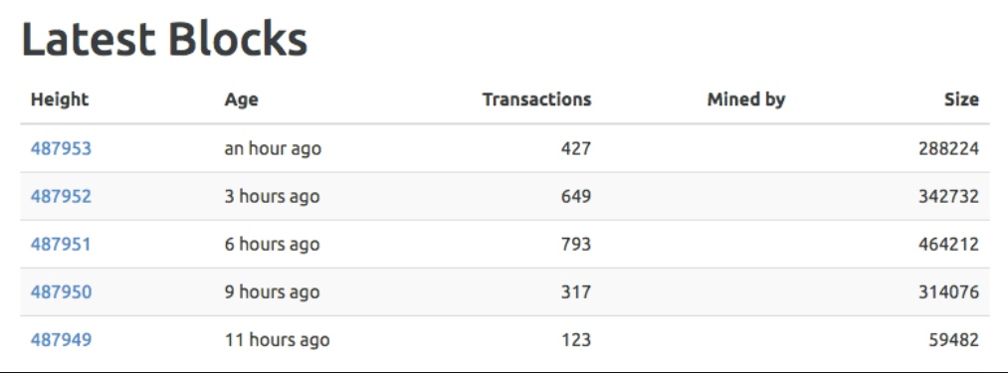
Block Explorer
Web App to Explore Blocks, Transactions, Accounts, Balances

Slide 51
Block Explorer
Implement the block explorer as Web app, at port 9999
Functionality:
View blocks
View confirmed transactions
View pending transactions
View accounts and balances
View peers
View network difficulty

Slide 52
Building a Blockchain
http://www.kingsland.academy

